Slide 1
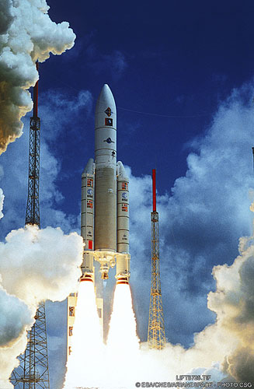
TourThrough the Solar System
Notes:
Solar System Tour

Slide 2
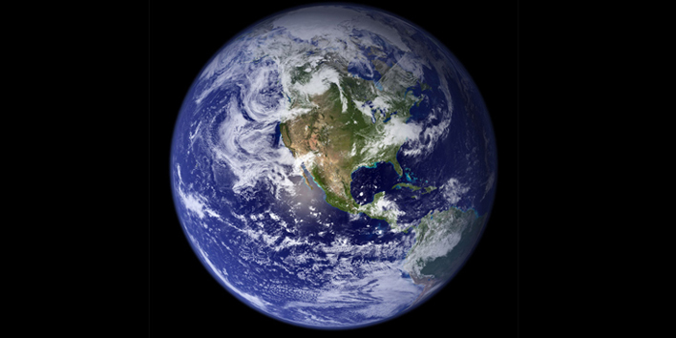
Notes:
Earth

Slide 3
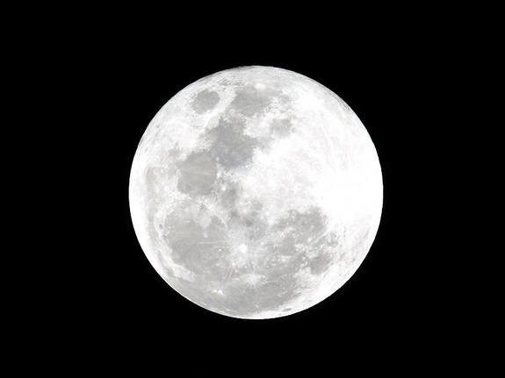
Notes:
Moon

Slide 4
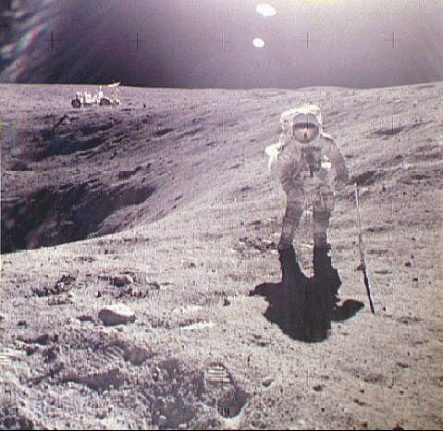
Notes:
Moon’s Surface

Slide 5
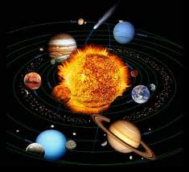
Notes:
Solar System

Slide 6
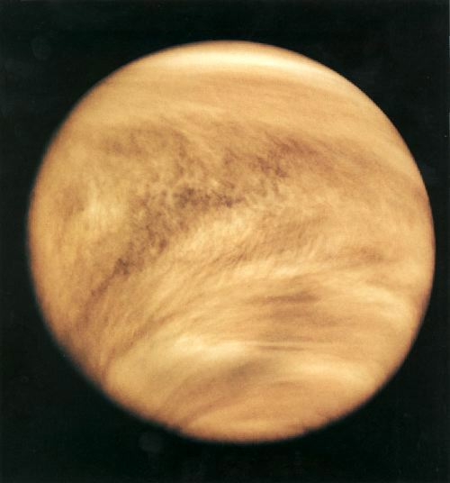
Notes:
Venus

Slide 7
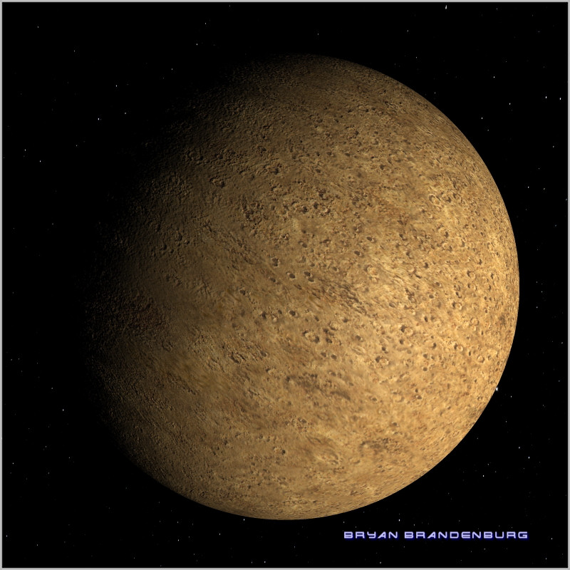
Notes:
Mercury

Slide 8
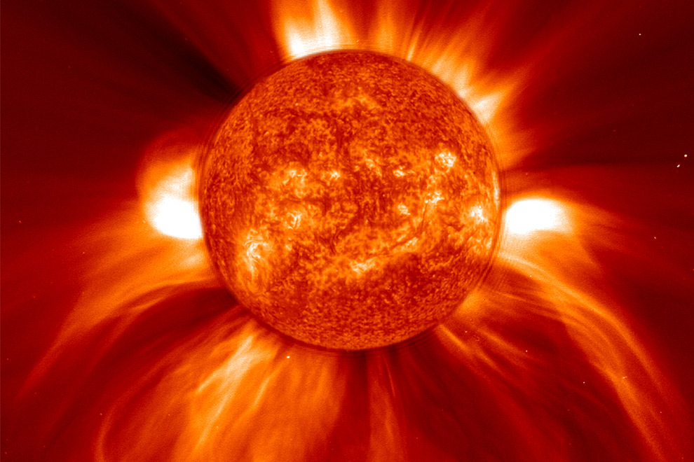
Notes:
Sun

Slide 9
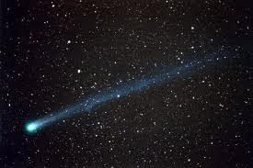
Notes:
Comets

Slide 10
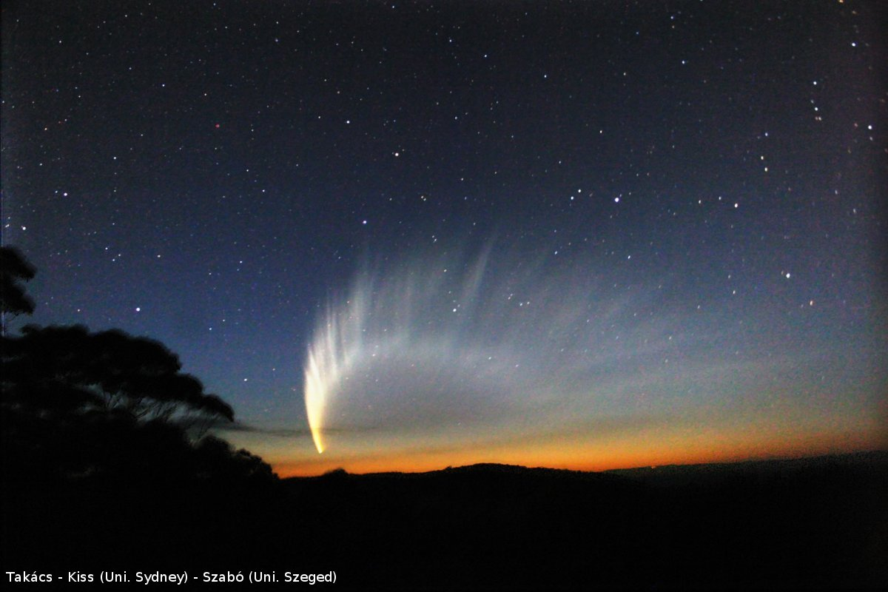
Notes:
Haley’s Comet

Slide 11
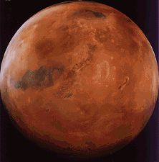
Notes:
Mars

Slide 12
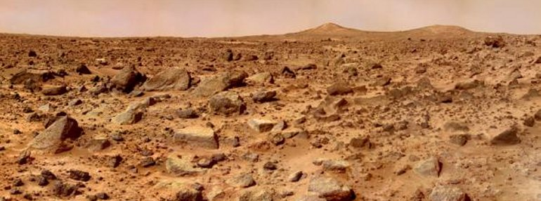
Notes:
Surface of Mars

Slide 13
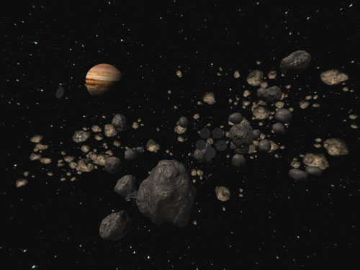
Notes:
Asteroid Belt

Slide 14
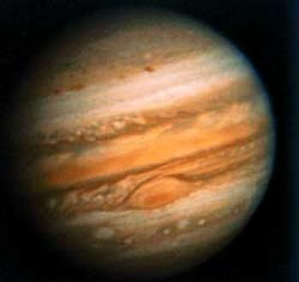
Notes:
Jupiter

Slide 15
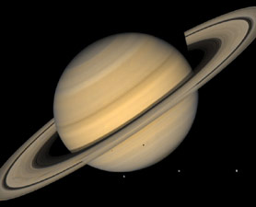
Notes:
Saturn

Slide 16
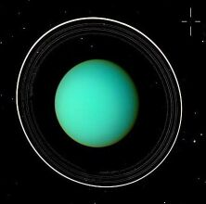
Notes:
Uranus

Slide 17
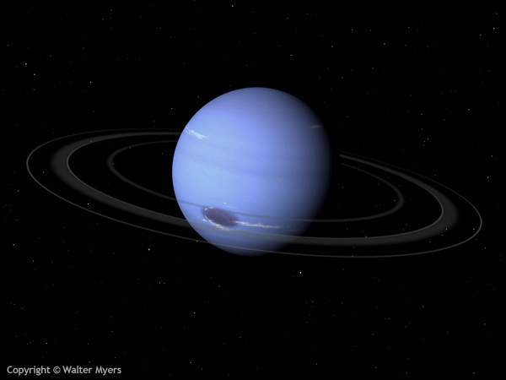
Notes:
Neptune

Slide 18
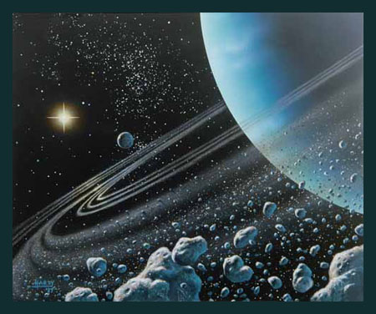
Notes:
Neptune’s Rings

Slide 19
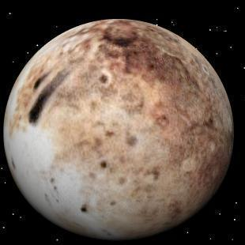
Notes:
Pluto

Slide 20
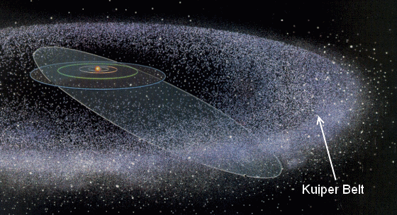
Notes:
Kuiper Belt

Slide 21
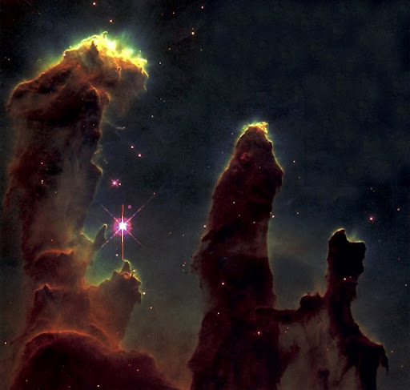
Notes:
Eagle Nebula

Slide 22
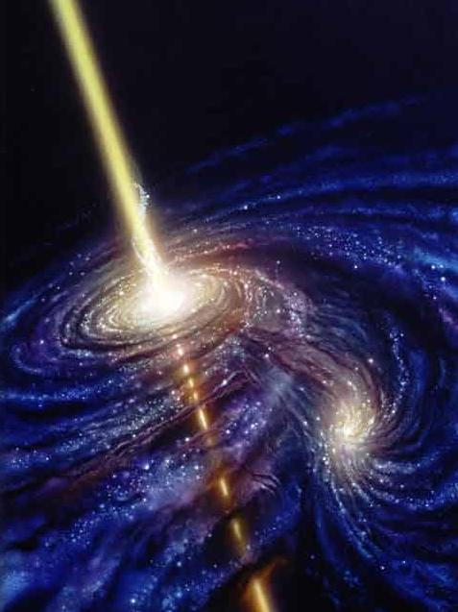
Notes:
Black Hole

Slide 23
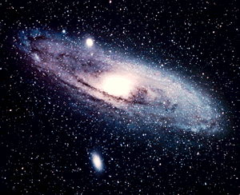
Notes:
Milky Way Galaxy

Slide 24
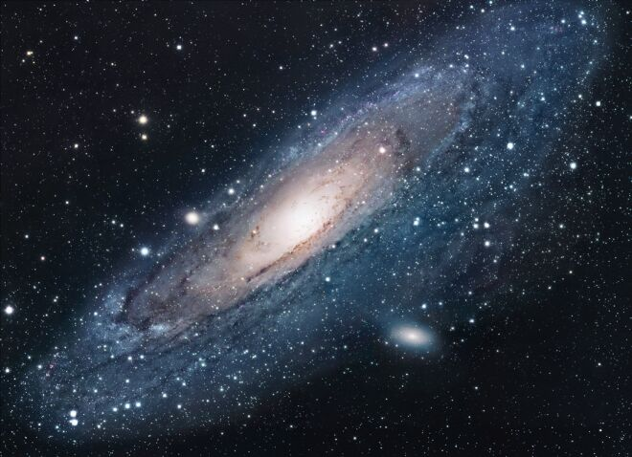
Notes:
Andromeda Galaxy

Slide 25
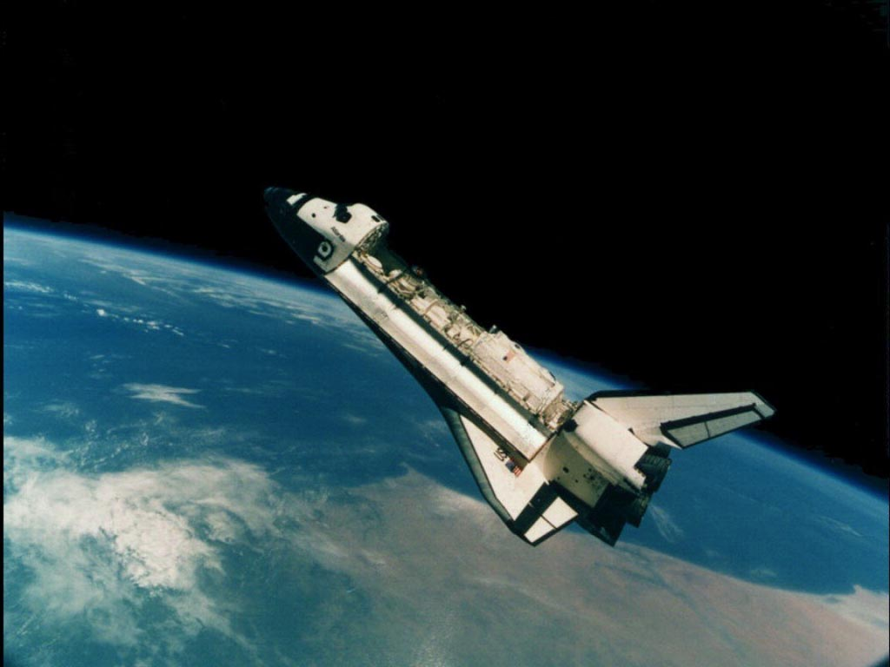
Notes:
Space Shuttle

